Slide 1
Sustrans Big Pedal at
Old Oak Primary School
Sustrans is the charity making it easier for people to walk and cycle.
Sustrans is a registered charity in England and Wales (number 326550) and Scotland (SC039263). © Sustrans 2021
Notes:
Welcome slide can be adapted for individual schools.

Slide 2
What is it?
Sustrans Big Pedal is the UK’s largest inter-school cycling, walking, wheeling and scooting challenge.
© 2017, Jonathan Bewley
Schools compete to see who can record the greatest number of active journeys over two weeks.

Slide 3
When is it?
The challenge runs from
Monday 19 April- Friday 30 April 2021.
© 2013, J Bewley. All rights reserved.

Slide 4
How long is it?
You can take part for all ten days of the challenge but only the best five days will decide your final position.
© 2015, Sustrans

Slide 5
“With over 2,000 journeys to school during the Big Pedal we visibly reduced the traffic congestion around the school gate and for the first time the parent car park had spaces.”
- Teacher, Claytons Primary School

Slide 6
Who can take part?
Teachers, parents and pupils are all invited to take part in the challenge.
Notes:
Teachers who take active journeys to school and parents who accompany a child/children at school are recorded as supporter journeys.
In 2019, almost 2.4m pupil journeys were logged in the challenge.
You can register an individual class to take part in the Big Pedal, or the whole school.

Slide 7
What do we do?
What do we do? Five day challenge
Cycle, walk, wheel or scoot to school every day and encourage your friends, school staff and parents to do the same.
Record your journeys on the Sustrans Big Pedal website and try to increase your score each day.
Notes:
We run a one and five day challenge. You’ll be asked to chose either the one day or five day challenge when you register.
Schools are able to record journeys on all 10 days of the competition for both options, the best five days (or one day) is chosen for your final score, depending on the challenge option you choose.
However, the more days you enter, the more potential there is to record higher participation rates and the more chances you have to win in our daily prize draw. Lesson plans are available for all 10 days.
When registered, schools have their own homepage where they can record their journeys and see how many pupils have taken part throughout the event.
If you have a roll size of 200 and 100 of them scoot or cycle to school, you would achieve a score of 50%.

Slide 8
What do we do?
What if schools are closed?
Pupils learning remotely can take an active journey from home with a family member or complete a 30 minute physical activity at home.
Journeys and challenges are recorded on the Sustrans Big Pedal website and count towards your school’s score.
Notes:
We will be providing daily inspiration for the 30 mins of physical activity at home.
What counts as a supporter journey when pupils are learning remotely?
When a child is learning remotely due to coronavirus, an adult accompanying that child on an alternative active journey or joining in the child’s daily physical activity counts as a supporter journey in the competition.
Staff members whose pupils are learning remotely can also count an alternative active journey or 30 minutes of physical activity as a supporter journey in the competition.

Slide 9
What do we do?
What do we do? One day challenge
Participants in the one-day challenge can also include activities carried out at school.
Cycling, walking, wheeling or scooting to school or for at least 30 minutes during the school day counts as one journey.
Notes:
In the one day challenge, each pupil can only record one journey a day, therefore, if a pupil cycles/walks/wheels/scoots to school that day AND cycles/walks/wheels/scoots continuously for at least 30 minutes during the school day this will only count as one journey in the challenge.
Remember, we run both a one and five day challenge. You’ll be asked to chose either the one day or five day challenge when you register.
Schools are able to record journeys on all 10 days of the competition for both options. The best one day (or five days) is chosen for your final score, depending on the challenge option you choose.
However, the more days you enter, the more potential there is to record higher participation rates and the more chances you have to win in our daily prize draw. Lesson plans are available for all 10 days.

Slide 10
Prizes
There will be fantastic prizes up for grabs on every day of the challenge. Schools that get over 15% of their pupils taking part on each day will be entered into the daily prize draw.
Prizes include accessories and equipment to help your school travel actively.
Notes:
Schools that record over 15% will be included in the prize draw each day and be in with a chance to win a prize for their school.
The school/class that records the highest percentage of pupils cycling or scooting to school overall (based on their best 5 days) will win their category and receive a certificate.

Slide 11
This year’s theme is Amazing Journeys
See your local area from a new perspective, learn about the benefits of active travel and discover amazing journeys to school from around the world.

Slide 12
Reasons to take part
Help keep children active and enjoying benefits of active travel.
Daily lessons and physical activity ideas suitable for remote learning
Log journeys every day to be entered into the daily prize draw

Slide 13
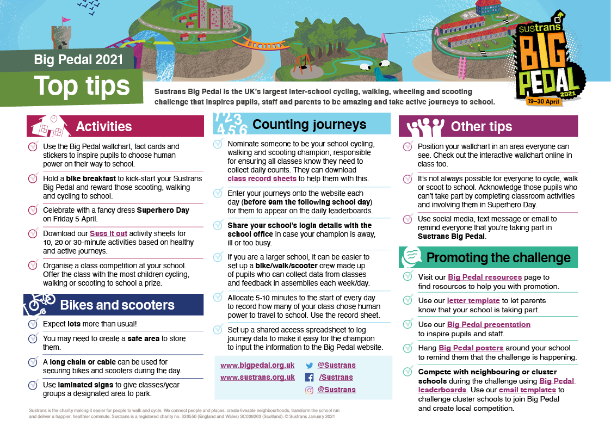
School Resources
Top Tips for running the challenge, email templates for you to send to parents, daily lessons suitable for remote learning. Plus daily physical
activity ideas.
All available to download free from
the Big Pedal website.

Slide 14
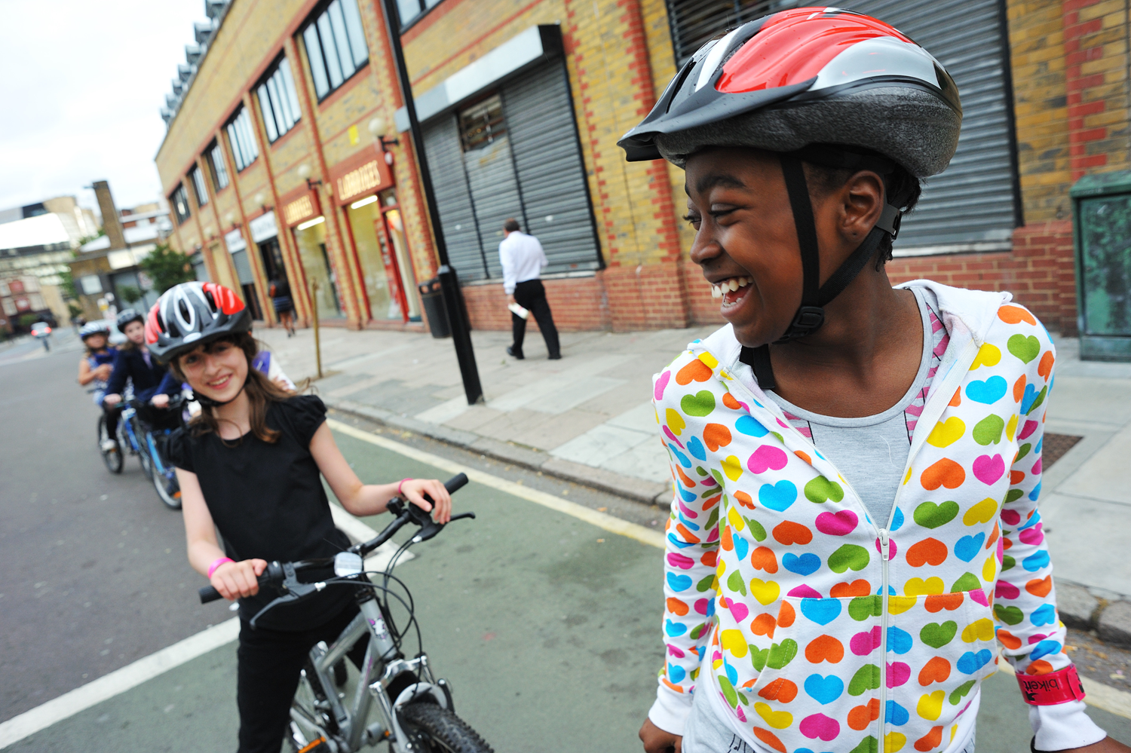
Amazing Me Fundraising Day
Celebrate all your amazing journeys and the final day of the challenge by wearing something that makes you feel amazing.
Schools can use this non-uniform event on Friday 30 April to fundraise for Sustrans or their own active journey projects.
© J Bewley/Sustrans
Notes:
Parents, staff and children are encouraged to wear something that they feel amazing in and decorate their bikes and scooters.
All money raised for Sustrans will enable thousands of children to have an active, fun and sustainable school journey.

Slide 15
Be part of something BIG
Our vision is a society where the way we travel creates healthier places and happier lives for everyone.
Celebrate the 50th anniversary of world Earth Day on the 22nd April by promoting greener, cleaner ways of travelling.

Slide 16
Register at
www.bigpedal.org.uk

Slide 17
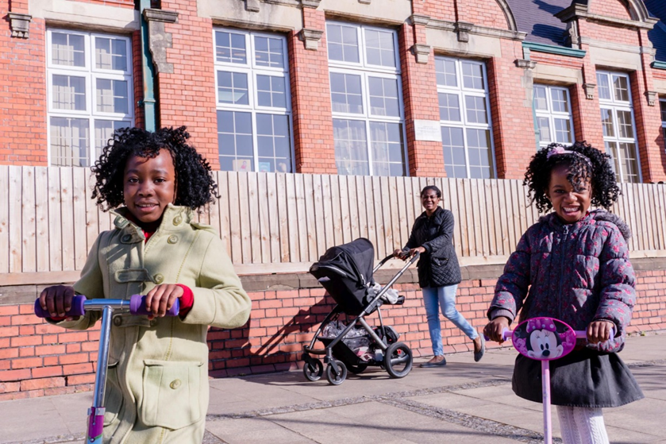
Good luck!
© 2017, Jonathan Bewley

